Slide 1


SME CUSTOMER PROTECTION REGULATION 2026
Strengthening fair banking practices
and customer protection for UAE SMEs

Slide 2

What’s changed?
The Central Bank of the UAE (CBUAE) has issued the small to medium sized enterprises (SME) customer protection regulation (circular C 2/2026), effective 13 September 2026, marking a significant development in the UAE's customer protection and market conduct framework for SME customers.
The regulation replaces the previous SME market conduct regulation and introduces
a more comprehensive customer-centric framework applicable to banks and finance companies operating in the UAE.
The new regulation shifts the focus from regulatory compliance to demonstrating fair customer outcomes across the entire SME customer lifecycle.
Key shift:
1
2
Governance
Customer outcomes
3
4
Transparency
Accountability

Slide 3

1
Governance takes center stage
The regulation places greater accountability on
boards and senior management to ensure that customer protection is embedded within the institution's governance framework and forms part of day-to-day decision-making.
Boards and senior management are now expected to:
Embed customer protection into governance
Oversee conduct risk
Monitor SME customer outcomes
Drive a customer-centric culture

Slide 4

2
Suitability, product governance
and responsible conduct
The regulation places greater emphasis on ensuring that financial products continue to meet the needs and interests of SME customers throughout their lifecycle.
Key expectations include:
01
02
Appropriate product design and target market identification
Fair, honest and professional conduct towards customers
03
04
Effective suitability assessments
Ongoing product
review and governance

Slide 5

3
Enhanced disclosure and
transparency requirements
SME customers should receive information that is clear, accurate and timely to support informed financial decisions.
Financial institutions should focus on:
01
02
Clear and transparent disclosures
Key facts statements
03
04
Consistent customer communications
Sufficient information to understand products and services

Slide 6

4
Complaints management and
customer redress
The regulation reinforces the importance of effective complaint handling as part of delivering fair customer outcomes.
Key expectations include:
Accessible complaint handling processes
Timely complaint resolution
Appropriate customer redress
Monitoring and analysis of customer complaint trends

Slide 7

5
Greater focus on
financially distressed SME’s
Customer protection extends beyond onboarding and product sales.
The regulation expects financial institutions to continue supporting SME customers throughout their relationship, particularly during periods of financial difficulty, while safeguarding customer information.
Key expectations include:
01
Early engagement with distressed SMEs
02
Fair collections practices
03
Debt restructuring support
04
Proportionate treatment through financial hardship

Slide 8

6
Data protection and customer
information governance
For the first time, the regulation introduces specific requirements relating to customer data governance, protection and breach management.
Institutions should consider:
01
02
Protection of customer information
Appropriate data governance
03
04
Secure handling of customer data
Data breach management and response

Slide 9

A question worth asking!
As implementation approaches, financial institutions may wish to consider a
simple question:
Can we demonstrate that our SME customers consistently receive fair outcomes throughout their lifecycle i.e., from onboarding and product selection to complaint resolution
and support during financial difficulty?
The answer often provides a useful indication of where implementation efforts should be focused ahead of the regulation's effective date.

Slide 10


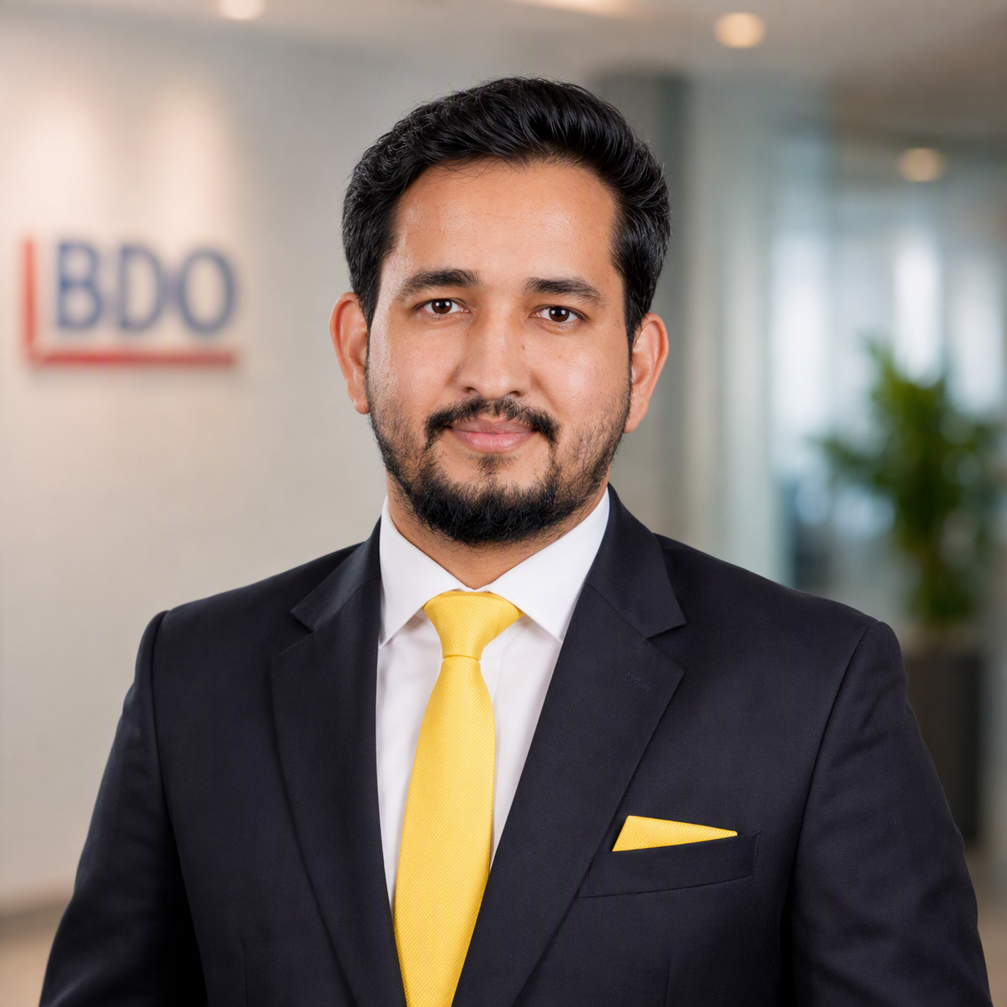
“Fair customer outcomes are no longer just a compliance expectation but a supervisory expectation.”
How can BDO help?
1
Regulatory gap assessments
2
Implementation support
LET’S CONNECT!
3
Policy and control reviews
Shivendra Jha
Partner - Head of Advisory Services and ILP
shivendra.jha@bdo.ae
+971 55 572 0269
4
Conduct risk assessment
5
Product governance reviews
Rahul Samdani
Director – Forensic, Risk & Compliance (FRC)
rahul.samdani@bdo.ae
+971 56 414 3952
6
Customer journey reviews
7
Staff training

